Slide 1

IMPATTO DELLA CHIRURGIA BARIATRICA SUL CANCRO DELLA MAMMELLA
Fouzia Mecheri MD, FACS
Responsabile Chirurgia Bariatrica
Ospedale Civile di Baggiovara
Chirurgia Generale, d'Urgenza e Nuove Tecnologie.

Slide 2
Female breast cancer
Most common cancer in women worldwide
2,3 million new cases in 2020 (11.7%), followed by lung (11.4%), colorectal (10.0 %), prostate (7.3%), and stomach (5.6%) cancers.
Lung cancer remained the leading cause of cancer death, with an estimated 1.8 million deaths (18%), followed by colorectal (9.4%), liver (8.3%), stomach (7.7%), and female breast (6.9%) cancers.
Primary cause of cancer death among women globally
Mortality: 600.000 per year

Slide 3
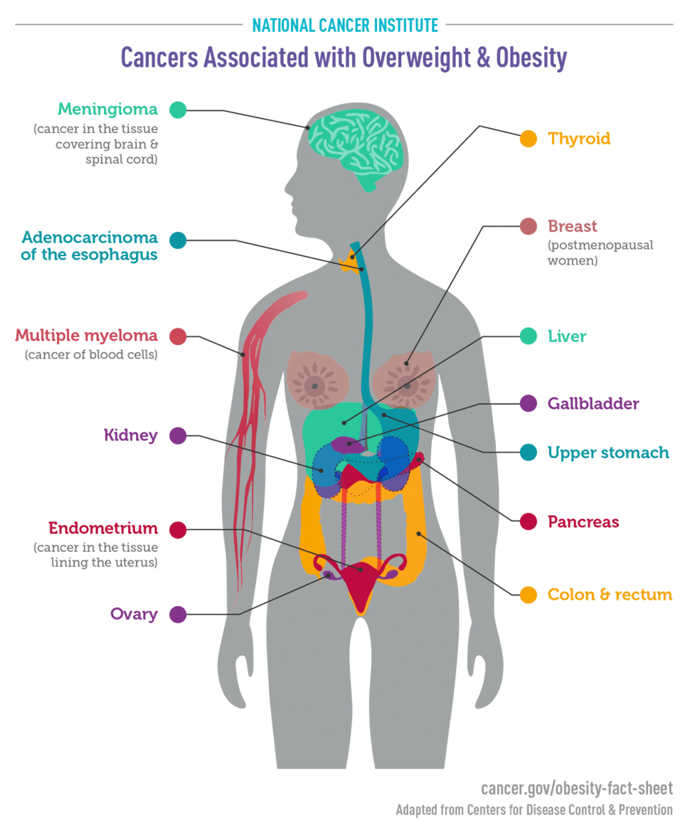
Being overweight or obese increases the risk 10 cancers:
BOWEL (COLORECTUM)
BREAST (post-menopause)
GALLBLADDER
KIDNEY
LIVER
OESOPHAGUS (oesophageal adenocarcinoma)
OVARY
PANCREAS
PROSTATE (advanced)
WOMB (endometrium)

Slide 4
Most common type of cancer mortality by country in 2020 among women

Slide 5
Risk factors for breast cancer
Age
Genetic mutations (BRCA1 and BRCA2)
Younger age at menarche
Nulliparity
First pregnancy after 30 years
Older age at menopause
Dense breast tissue
Personal and family history of BC

Slide 6
Modifiable risk factors for breast cancer
Environmental risk factors?
Unhealthy life styles:
unbalanced diets: the link between obesity and breast cancer is strongest in postmenopausal women due to producing more estrogen hormone from adipose tissue
Lack of exercise
Use of alcohol
Use of tobacco

Slide 7
Microbiota
The mammary gland has a unique microbiome because of:
A rich adipose tissue
an abundant blood supply
A important lymphatic drainage
A perfect environment for the proliferation of microorganisms

Slide 8
Microbiota
On the skin, mucous membranes, and especially in the intestine
Trillions of individual microrganisms
1014 heterogenous species of bacteria, viruses. archaea and fungi
Collective genome (microbiome) harbors 150-fold more genes than human genome
Dynamic balance with the host (eubiosis)
Microbial perturbations (dysbiosis)= risk of health problems

Slide 9
Microbiota
Digestion and absorption of indigestible carbohydrates (dietary fiber)
Production of Vitamin B and K
Metabolism of endogenous and exogenous compounds
Immunity (innate and cell-mediated)
Maintenance of intestinal barrier function
Immune response vs pathogenic microbes

Slide 10
Dysbiosis and cancer
Development of adiposity and obesity
Inducing chronic inflammation
Triggering uncontrolled innate and adaptative immune response
Altering the balance of host cell proliferation and death
Genomic stability and DNA damage

Slide 11
DNA damage and breast cancer
Healthy breast cells from women with a higher body mass index (BMI) had more DNA damage than those from women with a lower BMI. This finding is important because BRCA mutations lead to a reduced ability to repair DNA damage and a subsequent increased risk of breast, ovarian, and other cancers. (Science Translational Medicine)

Slide 12
Bariatric surgery and risk of cancer
A meta-analysis of 43 studies showed that women who were obese at breast cancer
diagnosis had an approximately 33% higher risk of mortality compared with normal-weight women
Effect of obesity on survival of women with breast cancer: systematic review and meta-analysis. Protani M, Coory M, Martin JH.Breast Cancer Res Treat. 2010
Patients undergoing bariatric surgery had a 33% lower hazard of developing any cancer during follow-up compared to a matched sample of control patients with severe obesity.
lower risk of incident cancer, particularly obesity-associated cancers, such as postmenopausal breast cancer, endometrial cancer, and colon cancer.
Bariatric Surgery and the Risk of Cancer in a Large Multisite Cohort
Daniel P. Schauer & all.
Ann Surg . 2019 January

Slide 13

Recommendations
Body fatness: be as lean as possible within the normal range of body weight
Physical activity: be physically active as part of every day life
Foods and drinks that promote weight regain
Plant foods: eat mostly foods of plant origin
Animal foods: limit intake of red meat and avoid processed meat
Avoid Alcoholic drinks, tobacco and limit consumption of salt
Breastfeeding: mothers to breastfeed – children to breastfed
Limit homone therapy: limiting the use of hormone replacement therapy after menopause can help reduce risk

Slide 14
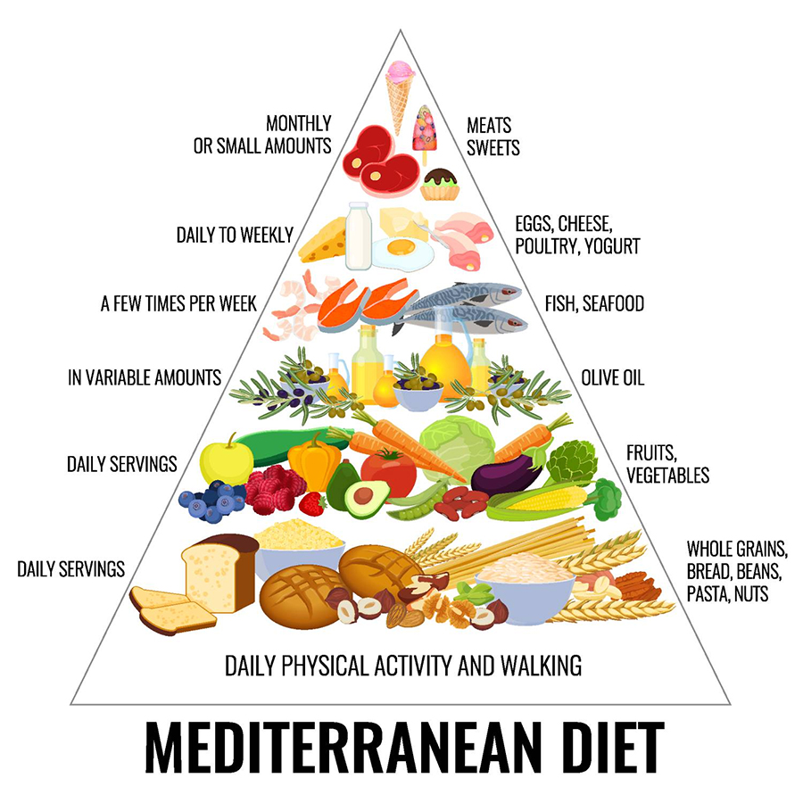
Recommendations
Weight
Cancer prevention
Diet
Physical
activity
AICR Guidelines for Cancer Prevention
Choose mostly plant foods, limit red meat and avoid processed meat.
Be physically active every day in any way for 30 minutes or more.
Aim to be a healthy weight throughout life.
And always remember don’t smoke or chew tobacco!

Slide 15
Conclusions
Women with overweight breast cancer and obesity often have a worse prognosis and develop resistance to hormone therapies more often than normal weight women.
Bariatric surgery is very effective for weight loss and long-term weight maintenance
Bariatric surgery appears to have a beneficial long term impact on the risk of cancer such as postmenopausal breast cancer
The risk of developing breast cancer increases by 10% for every 5-fold increase in BMI above 25 (AIRC 2021).

Slide 16
Grazie

